Slide 1

Energy system modelling using OSeMOSYS
LECTURE 9
ENERGY STORAGE MODELLING

Slide 2

Learning Outcomes
By the end of this lecture, you will be able to:
ILO1: Understand some key concepts around energy storage
ILO2: Learn how to represent storage technologies in OSeMOSYS
ILO3: Understand different settings for modelling storage technologies
2
Notes:
By the end of this lecture, you will achieve three key learning objectives. First, you will understand some key concepts around energy storage, exploring different types of storage systems, their mechanisms, and their role in balancing supply and demand, supporting renewable integration, and enhancing grid stability. Next, you will learn how to represent storage technologies in OSeMOSYS. We will guide you through the various components used to represent storage systems, such as power and energy components, and how to define critical parameters like capacity, costs, and efficiency. Finally, you will understand different settings for modelling storage technologies, including how to adjust parameters like charging and discharging efficiencies, minimum charge limits, and costs.

Slide 3
9.1 Energy Storage Systems (ESS)
ESS in the energy transition
Renewable integration
Electric vehicles
Microgrids
Distribution power quality
Peak management
Frequency regulation
9.1.1 Energy storage and energy transition
To combat climate change, a swift and comprehensive shift to net-zero emission energy systems is essential. Renewable energy will be pivotal in this transformation, making energy storage one of the most crucial elements in determining the feasibility and ease of achieving net-zero goals.
3
Notes:
Energy storage systems (ESS) are essential to the energy transition as they address the intermittency of renewable energy sources like solar and wind, enabling their integration into the grid. By storing excess energy during periods of low demand and releasing it during peak times, ESS ensures a consistent and reliable energy supply. These systems also enhance grid stability by providing frequency regulation, voltage support, and black start capabilities, which are critical for maintaining resilience in modern power systems. Additionally, ESS facilitates decentralized energy models, empowering households and businesses to store and use renewable energy while supporting microgrids in remote areas.
Beyond grid applications, ESS drives decarbonization by enabling the electrification of sectors such as transportation through batteries for electric vehicles. They also reduce dependence on fossil fuel plants for peak demand and provide economic benefits through energy arbitrage and deferred grid investments. Advanced storage technologies, from lithium-ion batteries to hydrogen-based systems, offer diverse solutions for various scales and needs, making ESS a cornerstone in achieving a sustainable and low-carbon energy future.

Slide 4
9.1 Energy Storage Systems (ESS)
9.1.2 Classification of energy storage systems
Thermal energy storage
Ex: Sensible heat storage using molten salts
Mechanical energy storage
Ex: Pumped hydro energy storage
Chemical energy storage
Ex: Hydrogen energy storage
Electrochemical energy storage
Ex: Battery energy storage
Electrical-magnetical energy storage
Ex: Supercapacitors
Others
Ex: Hybrid energy storage
4
Notes:
By 2030, energy storage requirements are expected to triple. This significant increase in demand has driven researchers to innovate and develop more efficient Energy Storage System (ESS) technologies capable of providing consistent and controlled power.
ESS technologies can be categorized based on several factors, including the form of energy stored, usage, duration, and efficiency. The figure shows the classification of ESS technologies by the type of energy stored, encompassing thermal, mechanical, chemical, electrochemical, and electrical forms. Hybrid systems, which combine two forms of energy storage, are also gaining importance.
We will explore specific examples of these technologies in the following slides.

Slide 5
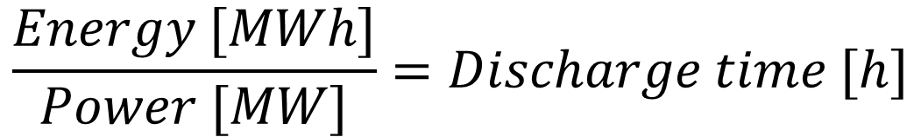
9.1 Energy Storage Systems (ESS)
9.1.3 Energy and power
Nominal energy capacity and power capacity define the size of a storage system, with the former representing the total energy it can store and the latter indicating the rate at which energy can be charged or discharged.
The energy-to-power (E/P) ratio is calculated by dividing the nominal energy capacity by the nominal power capacity. This ratio corresponds to the discharge time, indicating how long a storage system can deliver energy during a single discharge cycle at its nominal power output.
$$\frac{Energy [MWh]}{Power [MW]}=Discharge time [h]$$
Question: How long would it take to fully discharge an ESS with a nominal energy capacity of 1000 kWh and a nominal power capacity of 250 kW?
5
Notes:
In Energy Storage System (ESS) design, it is important to distinguish between the energy component and the power component. The energy component refers to the amount of energy that can be stored, while the power component indicates the rate at which the ESS can be charged or discharged.
For example, a lithium-ion battery system might have an energy capacity of 10 MWh and a power capacity of 2 MW. The energy-to-power ratio (E/P ratio) is defined as the quotient of energy capacity divided by power capacity. In this case, the E/P ratio is 10 MWh divided by 2 MW which is equal to 5 hours. This means the battery can fully charge or discharge in 5 hours when operating at its maximum power capacity.
ESS systems can also operate at lower power or energy levels. For instance, the same battery could charge at a rate of 1.5 MW over 3 hours, resulting in a stored energy of 1.5 MW×3 hours=4.5 MWh. However, the operational conditions of each system depend on specific requirements and should not significantly deviate from their nominal capacities to ensure optimal performance and longevity.

Slide 6
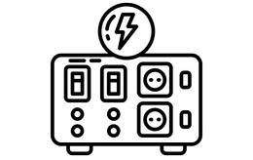
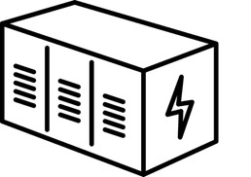

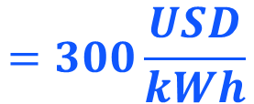
9.1 Energy Storage Systems (ESS)
9.1.4 Investment cost
Battery pack
Energy: 100 kWh
Inverter system
Power: 10 kW
Specific energy cost: Investment cost for energy capacity
Specific power cost: Investment cost for power capacity
$$=300\frac{USD}{kWh}$$
$$=250\frac{USD}{kW}$$
6
Notes:
Just as we distinguish between energy and power capacities in technical terms, we also differentiate them in cost terms. Specific energy cost refers to the investment required to install a certain energy capacity, while specific power cost is the investment required to install a certain power capacity.
This slide provides an example of a utility-scale lithium-ion battery:
The energy component consists of a 100 kWh battery pack. If the specific energy cost is 300 USD/kWh, the total energy cost would be 30,000 USD.
The power component, represented by the inverter system, has a specific power cost of 250 USD/kW. In this case, the total power cost would be 2,500 USD.
In our hands-on exercise, we will explore how to incorporate these separate costs into OSeMOSYS and determine the sizing of the components for optimal system design.

Slide 7
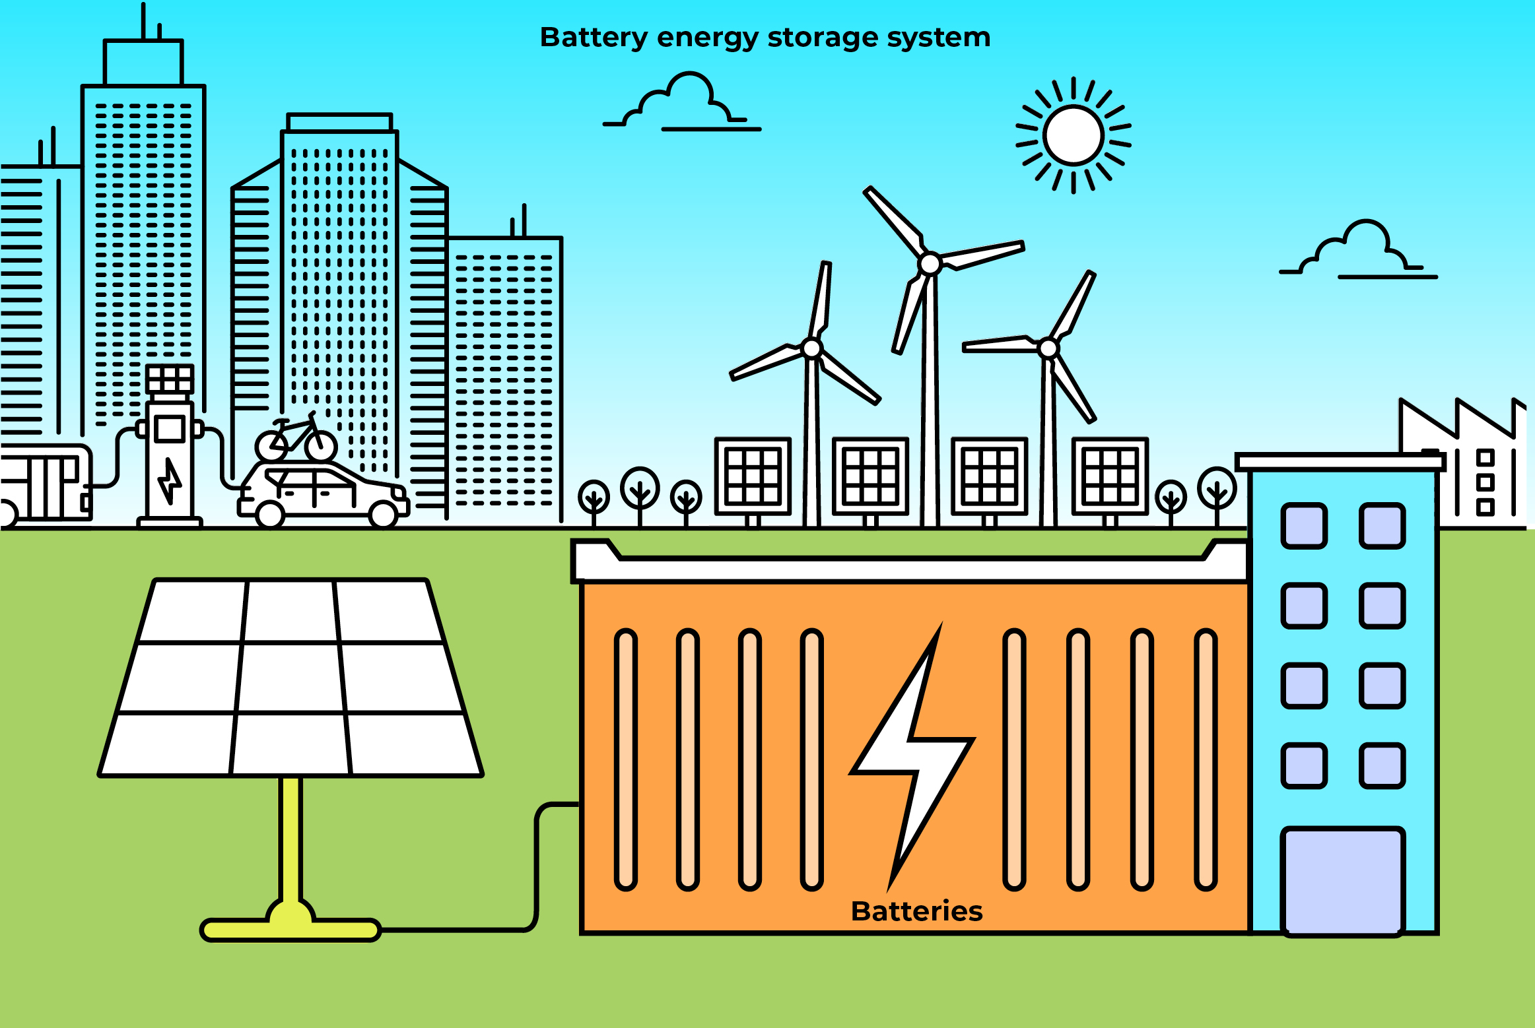
9.1 Energy Storage Systems (ESS)
9.1.5 Examples of energy storage systems - Batteries
7
Notes:
Batteries are electrochemical devices that convert chemical energy into electrical energy, as shown in the figure. They consist of several cells, each containing three key components: two electrodes—an anode and a cathode—and an electrolyte. Batteries are generally divided into two categories: primary and secondary. Primary batteries are designed for single use, where the chemical energy is consumed and cannot be recharged. In contrast, secondary batteries are designed to be rechargeable.
Secondary batteries are further classified into various types, including lead-acid (LA), lithium-ion, nickel-cadmium (Ni-Cd), sodium-sulfur (NaS), sodium-ion (Na-ion), and metal-air batteries, based on the materials used for the electrodes and electrolyte.

Slide 8
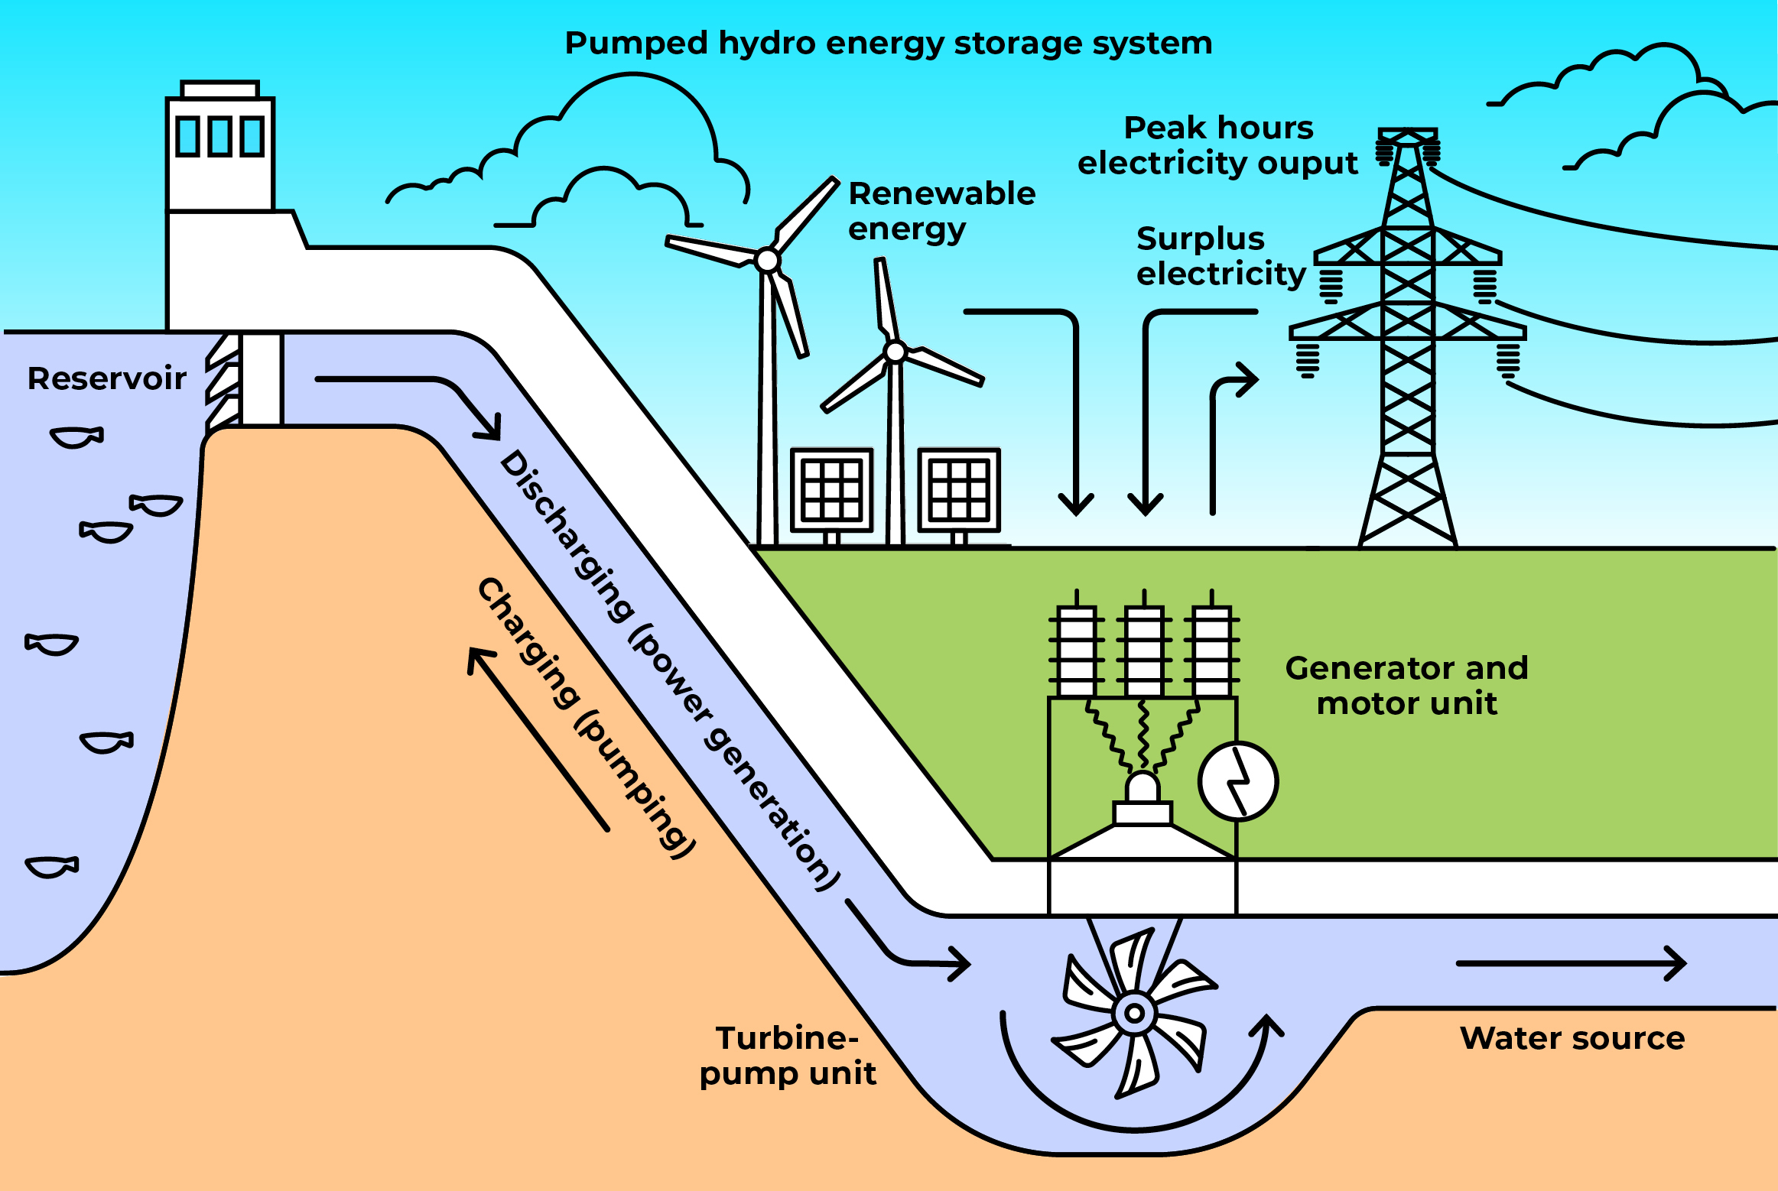
9.1 Energy Storage Systems (ESS)
9.1.6 Examples of energy storage systems – Pumped hydro storage
8
Notes:
The Pumped Hydro Energy Storage (PHES) is the most diffused energy storage system, characterised by its large energy capacity, long storage duration, and high efficiency. A typical PHES system consists of three main components: (i) two large reservoirs situated at different elevations, (ii) a pump unit that moves water from the lower reservoir to the higher reservoir, and (iii) a turbine that generates electricity as water flows downward from the upper reservoir to the lower one. The latter two are typically combined into a single unit, as depicted in the figure. The water released from the upper reservoir rotates the turbines, which in turn generate electricity through connected generators. By transferring water between the two reservoirs at varying elevations, the system stores and produces energy in the form of potential energy.
During off-peak hours (charging process), electrical energy from the power source is converted into mechanical energy, which is then transformed into potential energy by pumping water from the lower reservoir to the higher reservoir. During peak hours (discharging process), the stored water is released from the upper reservoir, flowing down to generate electricity.

Slide 9
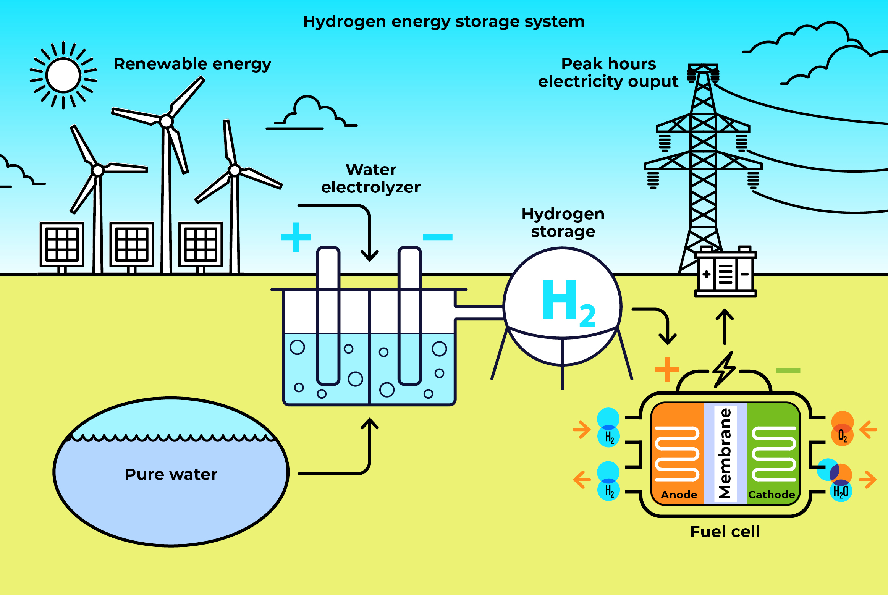
9.1 Energy Storage Systems (ESS)
9.1.7 Examples of energy storage systems – Hydrogen energy storage
9
Notes:
Hydrogen is considered a flexible energy carrier useful for storing electricity surplus. It can be produced either through the electrolysis of water or directly from sunlight via photocatalytic water splitting. A typical hydrogen energy system consists of three key components, as shown in the figure: (i) a hydrogen generation unit, such as an electrolyzer, which converts electrical energy into hydrogen, (ii) a hydrogen storage system, and (iii) a hydrogen energy conversion unit, like a fuel cell (FC) or regenerative fuel cell, which converts the stored hydrogen’s chemical energy back into electrical energy.
The charging process could use excess electricity to generate hydrogen through the water electrolysis process and store it in a tank or in underground caverns. Then, during annual peak demand periods, the discharging cycle could produce electricity from hydrogen through fuel cells.

Slide 10
Lecture 9.1 References
1. Schmidt O and Staffell I. (2023). Monetizing Energy Storage: A Toolkit to Assess Future Cost and Value. Oxford: Oxford University Press.
2. Mitali, J., Dhinakaran, S., & Mohamad, A. A. (2022). Energy storage systems: a review. In Energy Storage and Saving (Vol. 1, Issue 3, pp. 166–216). Elsevier B.V. https://doi.org/10.1016/j.enss.2022.07.002
10

Slide 11
9.2 Modelling energy storage in OSeMOSYS
9.2.1 Schemes of modelling part 1
An ESS in OSeMOSYS can be represented using two fundamental layouts
Layout 1 – Same technology to charge and discharge
Layout 2 – Distinct technologies to charge and discharge
Battery Energy Storage System
Power grid
Energy storage system
Power grid
Store ENERGY
Consume / Deliver POWER
Store ENERGY
Consume POWER
Deliver POWER
11
Notes:
Energy storage systems (ESS) can always be conceptualized as being composed of at least two key components working together to deliver storage services:
Power component: These manage the flow of electricity by withdrawing it from the grid during the charging phase and delivering it back during the discharging phase. There may be one or two power components in an ESS, depending on the system design.
Energy component: This stores the electricity received from the power components during charging and retains it until it is dispatched back to the grid during discharging.
In OSeMOSYS, power components are modeled as standard technologies, while the energy component is represented using storage-specific parameters, which will be introduced later in this lecture.

Slide 12
9.2 Modelling energy storage in OSeMOSYS
9.2.2 Schemes of modelling part 2
Different well known storage technologies can be represented using the two layouts.
Layout 1 – Same technology to charge and discharge
Layout 2 – Distinct technologies to charge and discharge
Battery energy storage system
Power grid
Hydrogen energy storage system
Power grid
Battery Pack
Inverter
Hydrogen tank
Electrolyzer
Fuel cell
12
Notes:
In this slide, we present a practical example of how two different storage technologies can be represented using OSeMOSYS. On the left, we have a utility-scale battery system, and on the right, a hydrogen energy storage system.
In the first case, the power component is represented by the inverter, which is bidirectional, meaning it functions in both charging and discharging modes. This is why a single element is used to represent the power component. The energy storage is represented by the battery pack.
In the second case, the power component of the hydrogen storage system consists of two elements: the electrolyzer, which converts electricity and water into hydrogen, and the fuel cell, which converts hydrogen back into electricity.
These examples can also be extended to other technologies, such as pumped hydro energy storage (PHES) or thermal energy storage systems.

Slide 13
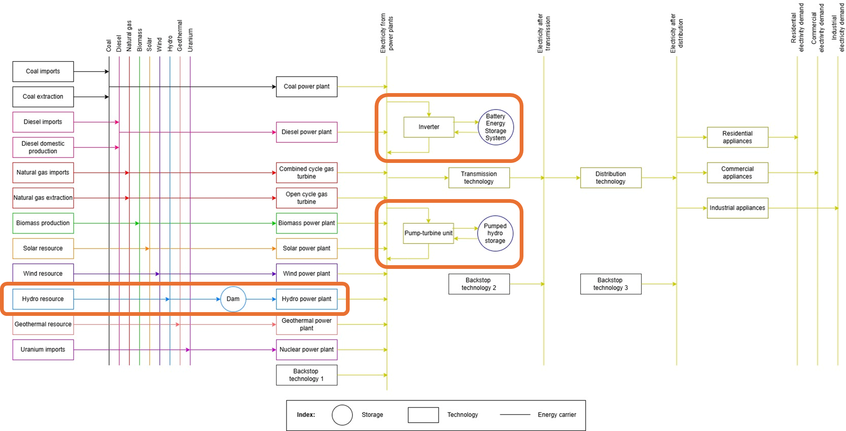
9.2 Modelling energy storage in OSeMOSYS
9.2.3 Storage in reference energy systems
13
Notes:
As mentioned earlier, we need to create power technologies in the same way we have created other technologies. However, the energy component should be defined using a separate set called STORAGE. In a reference energy system, this distinction is made by representing the energy component with a circle and the power component with a regular box.
In this slide, we present additional examples of how to represent hydro technologies. The first example corresponds to a storage hydropower system, where the hydro resource fills a dam, and then a power plant unit discharges this water resource to generate electricity. The second example is a pumped storage hydropower unit, which was explained earlier. In this system, a pump-turbine unit can charge or discharge the upper reservoir, allowing energy to be stored or produced based on demand.

Slide 14
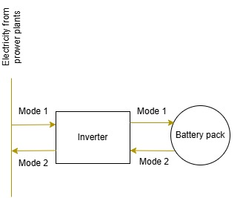
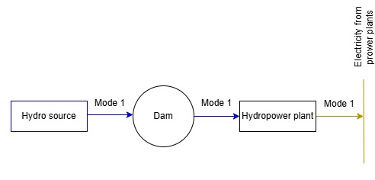
9.2 Modelling energy storage in OSeMOSYS
9.2.4 Defining storage technologies in OSeMOSYS
The parameters Technology to Storage and Technology from Storage are used to link the power and energy components in their corresponding modes of operation.
Two modes of operation must be defined to represent the charging and discharging processes when one single power technology is modelled.
14
Notes:
Since we have different components to represent a storage system, we need a way to link them in the model. The parameters that link a technology to its storage are Technology To Storage (which tracks the commodity flowing from the technology to the storage for charging) and Technology From Storage (which tracks the commodity discharged from the storage for use by the technology).
The definitions are as follows:
Technology To Storage: This parameter is 0 if the technology and storage are not linked in a certain mode, or a value > 0 if they are linked (the value depends on the units of activity used for both the technology and the storage).
Technology From Storage: This parameter is 0 if the technology and storage are not linked in a certain mode, or a value > 0 if they are linked (the value depends on the units of activity used for both the technology and the storage).
In cases where we use a single power technology, two different modes of operation must be created. This is because in OSeMOSYS, a single technology cannot perform two opposite actions in the same mode of operation. We will practice how to work with these parmeters and sets in the hands-on exercise.

Slide 15
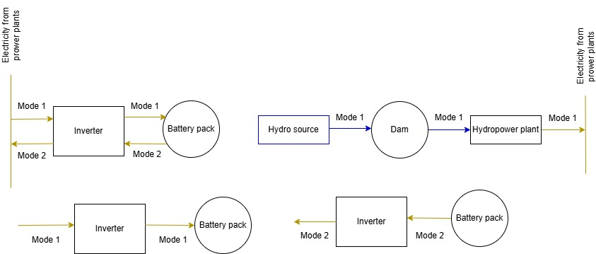

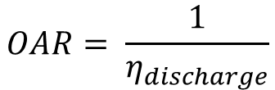


9.2 Modelling energy storage in OSeMOSYS
9.2.5 Efficiency
Defining the Input Activity Ratio (IAR) and Output Activity Ratio (OAR) for the power technology(ies) follows a similar process to conventional technologies. The main difference lies in the definition of the OAR.
Input Activity Ratio is the inverse of charging efficiency using Technology to Storage equal to 1.
Output Activity Ratio is the inverse of discharging efficiency using Technology from Storage equal to 1.
IAR = 1/ $η_{charge}$
$$IAR= \frac{1}{η_{charge}}$$
OAR = 1/ $η_{discharge}$
$$OAR= \frac{1}{η_{discharge}}$$
15
Notes:
The efficiency of the storage system can be accounted for through the Input and Output Activity Ratios (IAR and OAR) in a similar way to conventional technologies. Let’s use the example of a battery system to explain this concept.
For the charging stage, we define the input fuel for the inverter, which would be electricity in operation mode 1. There is no need to define the OAR in mode 1 because it is replaced by the Technology to Storage parameter. If we assume the Technology to Storage parameter is equal to 1, the IAR can be defined as the inverse of the charging efficiency.
Similarly, for the discharging stage, we define the output fuel for the inverter, which would also be electricity in operation mode 2. There is no need to define the IAR in mode 2 because it is replaced by the Technology from Storage parameter. If we assume the Technology from Storage parameter is equal to 1, the OAR can be defined as the inverse of the discharging efficiency.
It is important to note that energy losses during the storage stage are not considered separately. Therefore, the round-trip efficiency should account for both the charging and discharging efficiencies.

Slide 16
9.2 Modelling energy storage in OSeMOSYS
9.2.6 Other relevant parameters
Min Storage Charge
It sets a lower bound to the amount of energy stored, as a fraction of the maximum
Operational Life Storage
Useful lifetime of the storage facility
Capital Cost Storage
Investment costs of storage additions, defined per unit of storage capacity
Residual Storage Capacity
Existing defined storage capacities
16
Notes:
For storage technologies, new parameters are required to characterize them. First, the Min Storage Charge sets a lower bound on the amount of energy stored, expressed as a fraction of the maximum capacity, with a value ranging between 0 and 1. The storage facility cannot be emptied below this level.
Second, the Operational Life Storage represents the useful lifetime of the storage facility.
Third, the Capital Cost Storage reflects the specific investment cost of the energy component of the storage system.
Fourth, the Residual Storage Capacity represents the existing installed storage capacity.
Similarly, for power technologies, we use the same parameters discussed in previous lectures, such as Capital Cost, Fixed Cost, Operational Life, and Residual Capacity.

Slide 17
Lecture 9.2 References
1. KTH. (2018). OSeMOSYS Documentation. https://osemosys.readthedocs.io/en/latest/index.html#
17
17

Slide 18
Thank you
Consolidated by:
Fernando Plazas-Niño, Pietro Lubello
www.climatecompatiblegrowth.com

